Slide 1
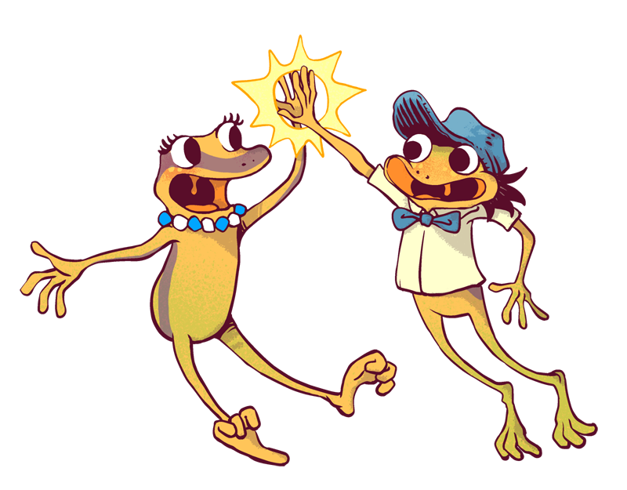
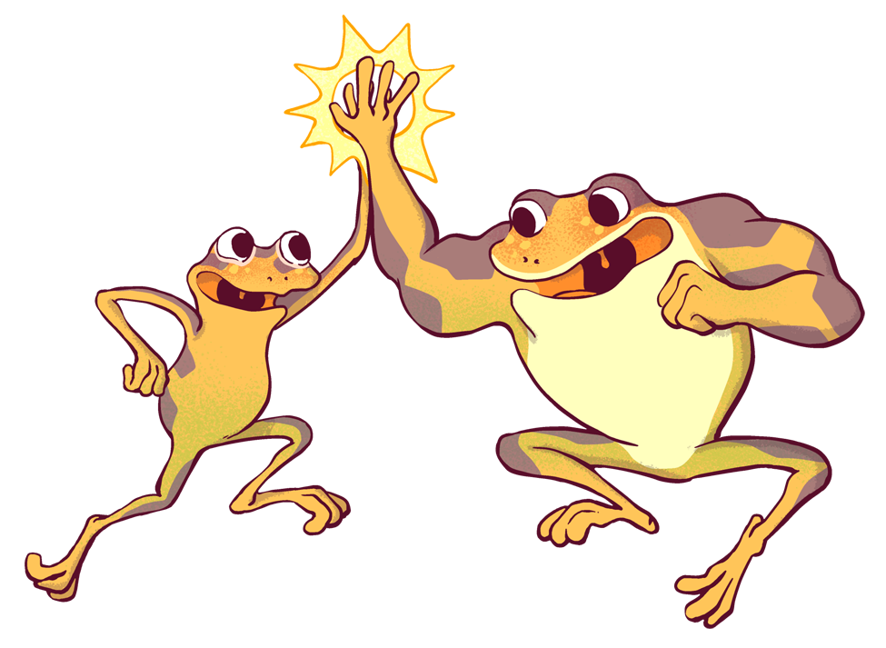


Helping Others
Digital Interactive Notebook
Student Name
Instructions
This Digital Interactive Notebook is designed to help you better understand helping others. It includes pages on vocabulary terms, images, strategies to better understand.
On each page you will see blue text boxes where you can type responses. Simply click in the box and begin typing to provide your response. You can also add your own text boxes by clicking on the text box icon ( ). You also will need to add images to various pages. You can do this by clicking on the “Image” icon ( ) or by going to “Insert > Image” in the menu.
Each text box can also be resized using the borders so that each fits on your pages.

Slide 2

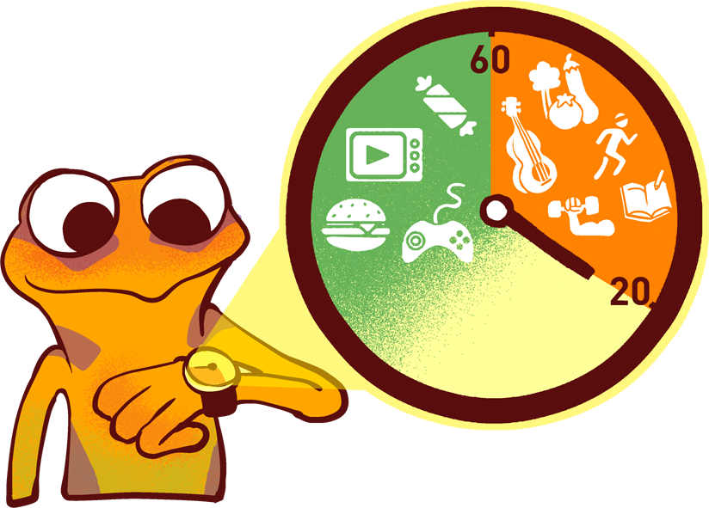

HELPING OTHERS HIERARCHY
Directions: Identify the different levels of helping others and give details on each level.
Self-actualization
Self image/esteem
Belonging
Safety
Basic needs

Slide 3

Identifying different ways to help others:
Directions: Fill in the blank on each sign.
Belonging:
Basic Needs:
Safety:
Self-actualization:
Self-image/esteem:
Notes:
“real life examples”

Slide 4
Helpful Illustrated Vocabulary
Directions: Research each vocabulary term below and type your own definition in the 2nd column. Then look for an image that best symbolizes it and insert it in the 3rd column.
Vocabulary | Definition | Image
Self-actualization
Self-image/esteem
Belonging
Safety
Basic needs

Slide 5
What other areas could someone need help with?
What are the five big issues currently present?
Notes:
Is there things happening in school now, relevant to Maslow’s hierarchy? Example -- inequity? bullying?

Slide 6

Type text here
Reflection...
Type text here
Notes:
Examples would be -- I can be more helpful by … I will be more helpful by … I need others to help me by …

